Slide 1

Array Basics
Casey mCcullough
For tech elevator

Slide 2
The Array
The entire array
has a single name
Each value has a numeric index
0 1 2 3 4 5 6 7 8 9
scores
79 87 94 82 67 98 87 81 74 91
Notes:
An array is an ordered list of values of the same data type.
Any one of the data values can be referenced
with the name of the array and the numeric index.

Slide 3
Array elements
an individual data component of an array
referenced by the array name and subscript
height
0
52
1
81
height [2]
2
54
3
53
4
64
5
55
6
66
7
57

Slide 4
Array elements
an individual data component of an array
referenced by the array name and subscript
height
0
52
1
81
height [7]
2
54
3
53
4
64
5
55
6
66
7
57

Slide 5
height
0
52
height [8]
1
81
2
54
3
53
java.lang.ArrayIndexOutOfBoundsException: 8
4
64
5
55
6
66
7
57

Slide 6

Applications of Arrays
Imagine a program that keeps track of high temperatures for a given city for an entire year.

Slide 7
double cleHighTemp1;
double cleHighTemp2;
double cleHighTemp3;
double cleHighTemp4;
double cleHighTemp5;
double cleHighTemp6;
double cleHighTemp7;
double cleHighTemp8;
double cleHighTemp9;
double cleHighTemp10;
double [] cleHighTemp = new double [365];

Slide 8
Arrays
An array element can be used anywhere an individual variable (or object) could be used.
For example, an array element can be
assigned a value scores[2] = 89;
Printed System.out.println ("Top = " + scores[5]);
Used in a calculation:
scores[first] = scores[first] + 2;
mean = (scores[0] + scores[1])/2;

Slide 9
What arrays can store
“If”
“you”
“think”
“you”
“can”
The element type can be a primitive type or an object reference
Therefore, we can create an array of integers, or an array of characters, or an array of String objects, etc. Even an array of Buildings, or Dice, or Monsters!
An array of Strings

Slide 10
Arrays as objects
In Java, the array itself is an object
Therefore the name of the array is a object reference variable, and the array itself must be instantiated
int[] scores = new int[10];
The type of the variable scores is int[] (an array of integers)

Slide 11
Connecting arrays with references to arrays
double data [] = new double[5];
char letters[] = new char[8];
Or . . .
int scores[]; // creates an array reference
scores = new int [100]; // now connected

Slide 12
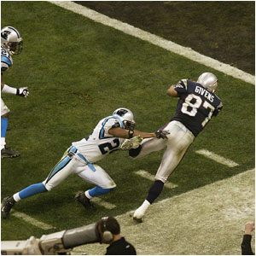
Bounds Checking
Once an array is created, it has a fixed size
An index used in an array reference must specify a valid element
That is, the index value must be in bounds (0 to N-1)
What happens when we try to
reference an out-of-bounds element?
Notes:
What happens when we try to reference an out-of bounds element?
The Java interpreter throws an ArrayIndexOutOfBoundsException if an array index is out of bounds
This is called automatic bounds checking

Slide 13
Bounds Checking and length.
Each array object has a public constant called length that stores the size of the array
It is referenced using the syntax: arrayName.length:
0 1 2 3 4 5 6 7 8 9
79 87 94 82 67 98 87 81 74 91
scores
int numScores = scores.length; // ??

Slide 14
Name the last element
0 1 2 3 4 5 6 7 8 9
79 87 94 82 67 98 87 81 74 91
scores
int lastScore = // ??
int lastScore = scores[scores.length – 1];

Slide 15
Write a for loop that prints all values in scores*
0 1 2 3 4 5 6 7 8 9
79 87 94 82 67 98 87 81 74 91
scores
* Irrespective of its length

Slide 16
Write a for loop that prints all values in scores
0 1 2 3 4 5 6 7 8 9
79 87 94 82 67 98 87 81 74 91
scores
for (int i = 0; i < scores.length; i++){
System.out.println (scores[i]); }

Slide 17
Initializer Lists
An initializer list can be used to instantiate and initialize an array in one step
The values are delimited by braces and separated by commas
Examples:
char[] letterGrades = {'A', 'B', 'C', 'D', ’F'};
int[] primes = {2, 3, 5, 7, 11, 13};

Slide 18
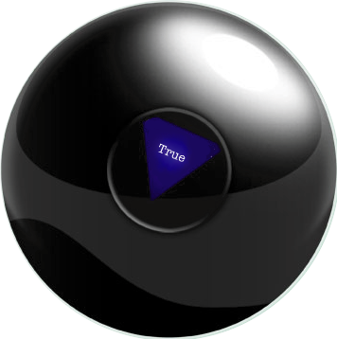
Initializer Lists
Note that when an initializer list is used:
the new operator is not used
no size value is specified
The size of the array is determined by the number of items in the initializer list
An initializer list can only be used only in the array declaration
See MagicEightBall.java

